Slide 1
Capstone Project - The Battle of Neighborhoods Week 2
Fast- Casual Vietnamese Restaurant in Toronto

Slide 2
Overview
Create a recommendation of a neighborhood in central Toronto to open a new location for US based fast-casual Vietnamese restaurant chain.
The restaurant should not compete with other Vietnamese restaurants
The location must be in a busy area to get a lot of traffic during the lunch hours.

Slide 3
DATA and Methodology
Data from Foursquare and Wikipedia were used to get the geospatial and restaurant data of Toronto
Neighborhoods were grouped and clustered into areas
Restaurants were sorted by category such as Italian or Vietnamese
Restaurant categories were ranked from most common type of venue to least common type of venue per neighborhood.
The clusters were then overlaid on a map and a report was generated for each cluster

Slide 4
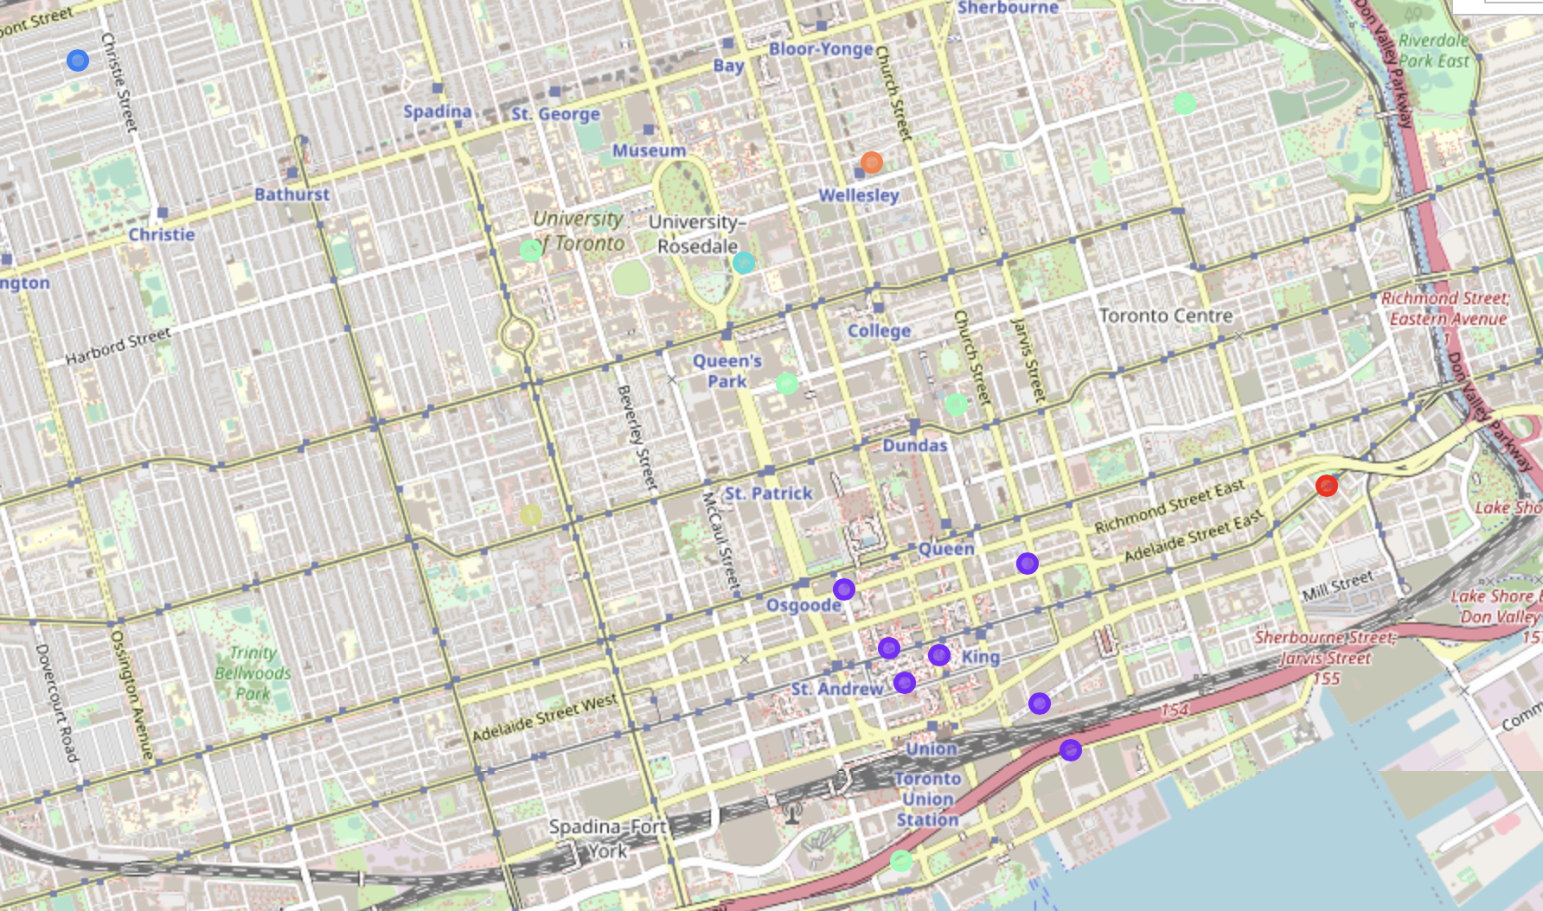

Cluster Map

Slide 5
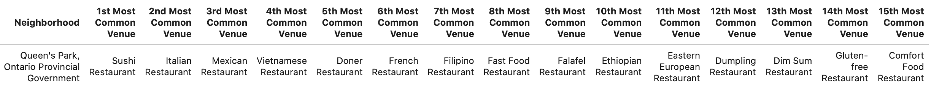




Clusters that don’t work out
Clusters 1,3,4 &6 have quite a few Vietnamese restaurants in them
Cluster 1
Cluster 3
Cluster 4
Cluster 6

Slide 6
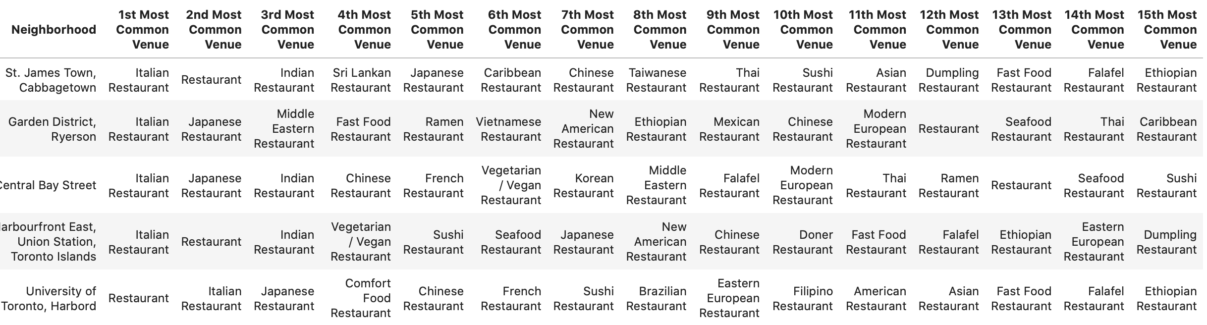
Clusters that don’t work out Continued
Cluster 5 has Vietnamese restaurants and it is also in more residential areas and not business districts although the University of Toronto neighborhood could be a location, but the cluster overall is not
Cluster 5 has Vietnamese restaurants and it is also in more residential areas and not business districts although the University of Toronto neighborhood could be a location, but the cluster overall is not

Slide 7
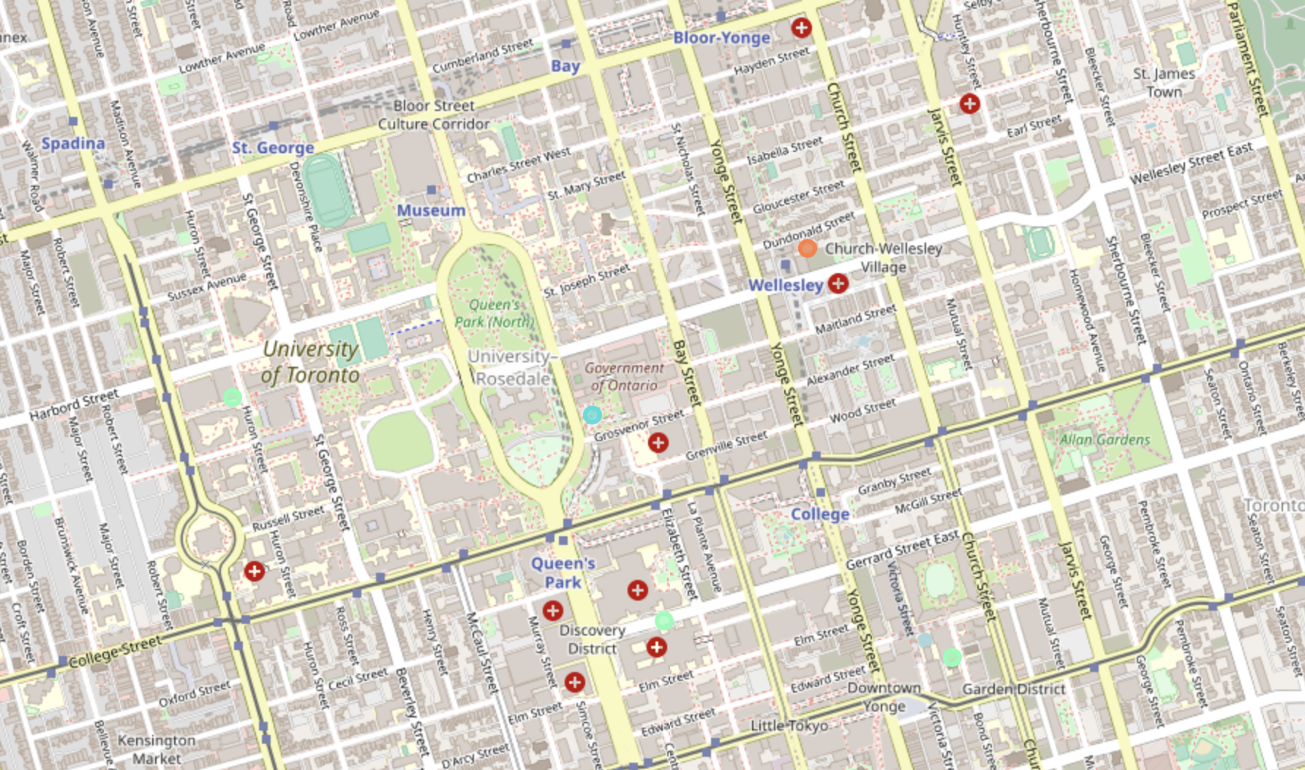

Clusters that don’t work out Continued
Cluster 7 has no Vietnamese restaurants, but it is on the outskirts of the university so probably not a lot of foot traffic there for lunch hours.

Slide 8
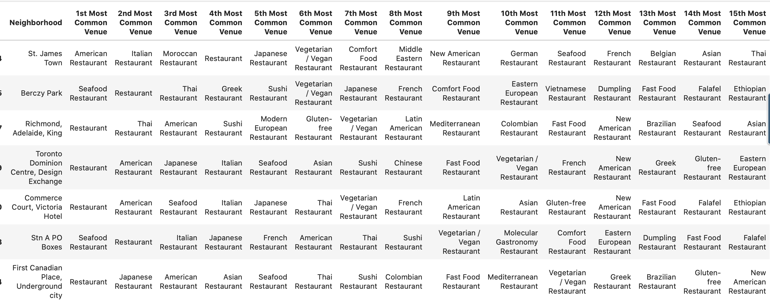
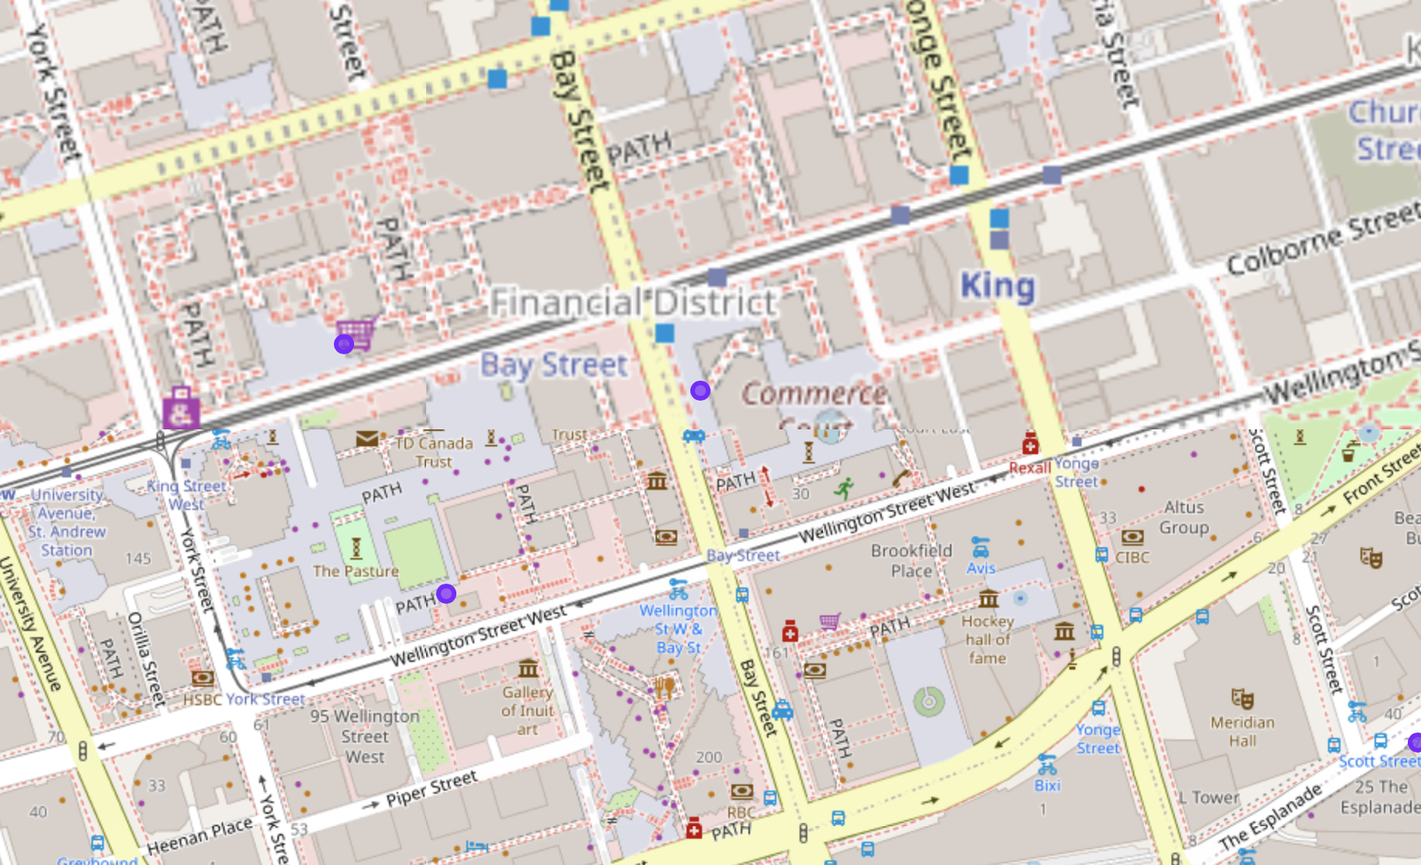

Best Cluster and Location
Cluster 2 is the best because it has many neighborhoods, few Vietnamese restaurants and is in the heart of the Business District in Toronto. More specifically the Commerce Court Neighborhood would be great.

